Slide 1



TRACK 2: DATA SCIENCE
Sponsored by:
Powered by:
HACK THE MACHINE 2021
CHALLENGE 3
TEAM NAME: NoSkill
TEAM MEMBERS: Cyrus Simons

Slide 2

Challenge 3: Visualizations and Explanations
Challenge 3 will be a summary of work from both Challenge 1 and Challenge 2 and submitted as a PowerPoint presentation.
Exploratory Data Analysis
Model Performance
Submissions are due on Day 3: November 18th at 1700 EST/ 1400 PST
Resources

Slide 3

Exploratory Data Analysis

Slide 4
Exploratory Data Analysis: Part 1
As a graduate student studying AI, it was natural for me to choose this track.
At first, it seemed easy, and then I ran into some convoluted problems with the data itself.
I needed a way to re-balance the distribution since our source data was imbalanced. i.e. 95% negative and 5% positive spread.

Slide 5
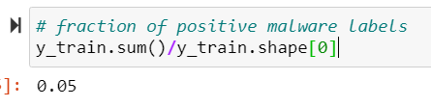
Exploratory Data Analysis: Part 2
Data spread: 95% negative and 5% positive

Slide 6
Exploratory Data Analysis: Part 3
Coming up with a simple and powerful solution to this imbalance:
Reading the paper Learning to Detect and Classify Malicious Executables in the Wild
Applying high performance models from this paper (the data is different, but methodology is very similar)
Decided upon SciKit-Learn’s C-Support Vector Machine with a ‘balance’ parameter:
SVC( C=100, kernel='poly', degree=3, gamma='scale', coef0=10.0, shrinking=True, probability=False, tol=1e-3, cache_size=100, class_weight='balanced', verbose=True, max_iter = -1)
This prevents the model weights from prioritizing the negative data which is in abundance
This wasn’t good enough, the f1 score capped at about 0.70. With the right pipeline (standard scaler, normalization and SVC), it improved the f1, precision and recall all above 0.95.

Slide 7

Model Performance

Slide 8
Model Performance: Part 1
Since the model performed so poorly at first using a bayes classifier, and it was found that the SVC performed exponentially better, I stuck with the SVC.
There were more hyperparameters to play with, the class_weight=‘balanced’ seemed to solve the imbalanced dataset problem and a regularization parameter.
I tested the f1 score, precision and recall against a dummy (random) classifier from SciKit-Learn.

Slide 9
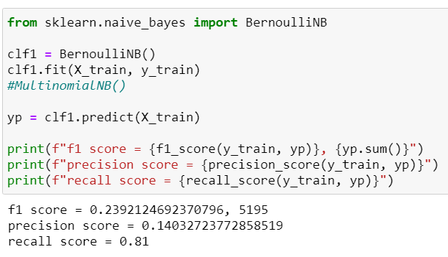
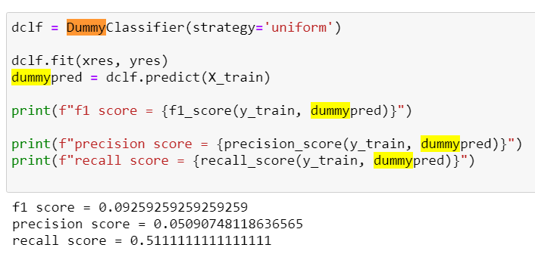
Model Performance: Part 2
Evaluation of the dummy model to set a baseline
Since this is what I had to beat, the bayes was a little better, but had way too many positive classifications (there are only 900 I the original data)

Slide 10
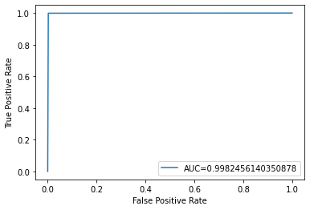
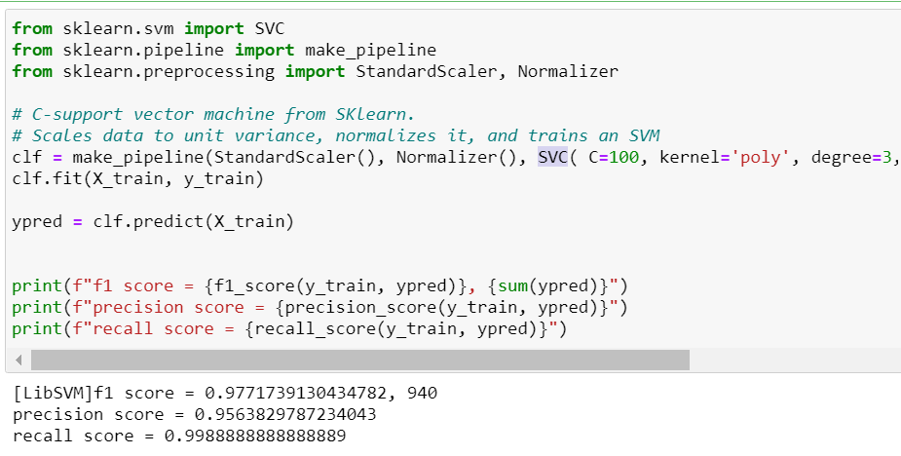
Model Performance: Part 3
Developing the SVC pipeline. Mostly a result of experimentation. I saw that SVC was heavily documented, and StandardScaler was also commonly used, but it seemed as if the data was scaled, but not normalized. This is where Normalizer() comes into play. It wipes the other models out of the water.

Slide 11

Resources

Slide 12
Resources
The rise of machine learning for detection and classification of malware:Research developments, trends and challenges
Learning to Detect and Classify Malicious Executables in the Wild∗
Working with text data — pandas 1.3.4 documentation (pydata.org)
AdaBoost Classifier Algorithms using Python Sklearn Tutorial – DataCamp
sklearn.svm.SVC — scikit-learn 1.0.1 documentation
1.4. Support Vector Machines — scikit-learn 1.0.1 documentation

